Slide 1
Predicting Semiconductor Wafer Failures From Process Equipment Sensor Data
Springboard’s Introduction to Data Science (Capstone Project)
By
John Campi
March, 2019

Slide 2
Outline
Introduction
Data Exploration
Modeling
General Logistic Model
Random Forest
Conclusion and Recommendations

Slide 3
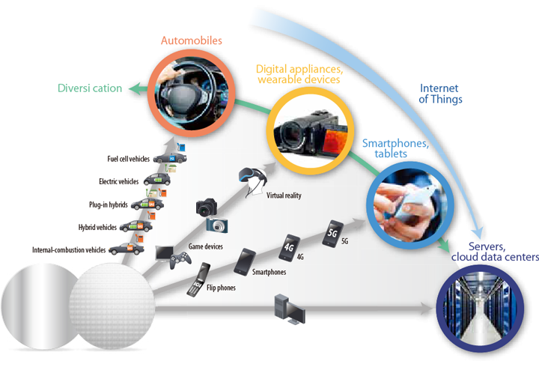
Semiconductors Drive the IoT Industry

Slide 4

Major Fabrication Steps in CMOS Processing
There are dozens to hundreds of fabrication step in a wafer fab flow.
Each step involves equipment fitted with multiple sensors.
Sensor data can be mined to model and predict final pass/fail wafer status.

Slide 5
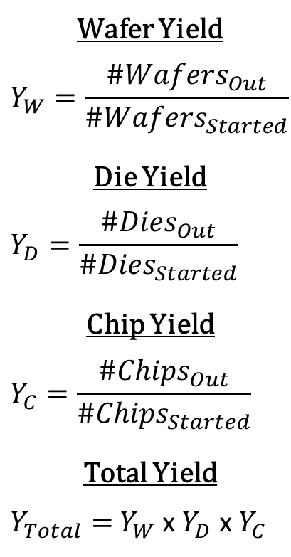
Yield Defined
Wafer Yield
$$Y_{W}=\frac{{\#Wafers}_{Out}}{{\#Wafers}_{Started}}$$
Die Yield
$$Y_{D}=\frac{{\#Dies}_{Out}}{{\#Dies}_{Started}}$$
Chip Yield
$$Y_{C}=\frac{{\#Chips}_{Out}}{{\#Chips}_{Started}}$$
Total Yield
$Y_{Total}=$ $Y_{W}$ x $Y_{D}$ x $Y_{C}$
Yield is defined by (#item output / #items started).
Fab yield is defined as wafer yield x die yield x chip yield.
This project is concerned with wafer yield only.

Slide 6
Yield Loss Strongly Affects Bottom Line
# Process Steps | 225
# Chips / Wafer | 100
Material [$/wafer] | $200
Processing [$/wafer/step] | $2
Packaging [$/chip] | $2
Price [$/chip] | $20
wafer starts /day | 1500
Assumed daily costs above.
Ignores die & chip yield.

Slide 7
Outline
Introduction
Data Exploration
Modeling
General Logistic Model
Random Forest
Conclusion and Recommendations

Slide 8
Data Set
Metric | Initial | Final
# of Variables | 593 | 417
# of Observations | 1567 | 1567
# passing | 1463 | 1463
# failing | 104 | 104
% Missings | 4.51 | 0
SECOM Dataset: http://archive.ics.uci.edu/ml/datasets/secom
Initial dataset:
Contains 593 variables, 590 are sensor data.
1567 observations – one per wafer.
1463 pass, 104 fail
4.51% of data are missing.
After data wrangling:
417 variables, 414 are sensor data.
All missings imputed.

Slide 9
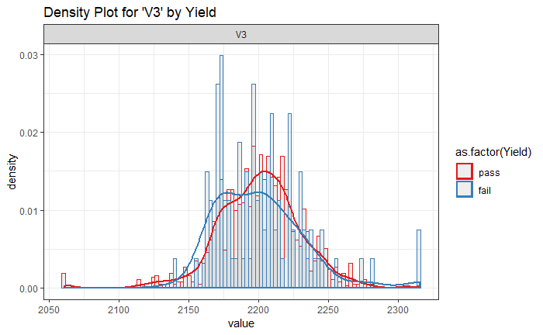
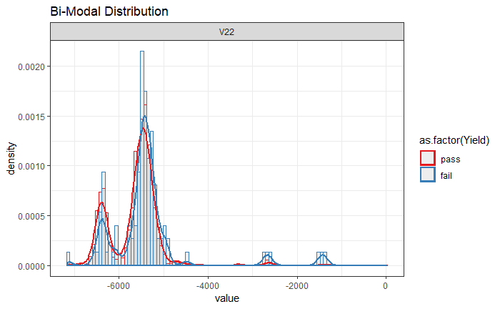
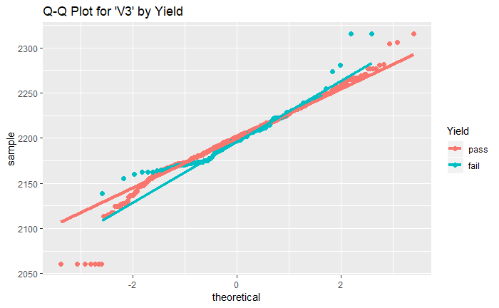
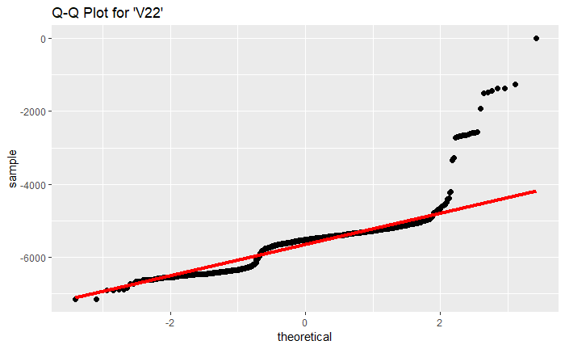
Sample Sensor Data PDF and Q-Q Plots
Sensor V3 PDF exhibits “normal” behavior.
Q-Q plot linear behavior between z = +/-1.96 treated as normal distribution.
Bimodal distributions treated as normal based on this criteria.

Slide 10
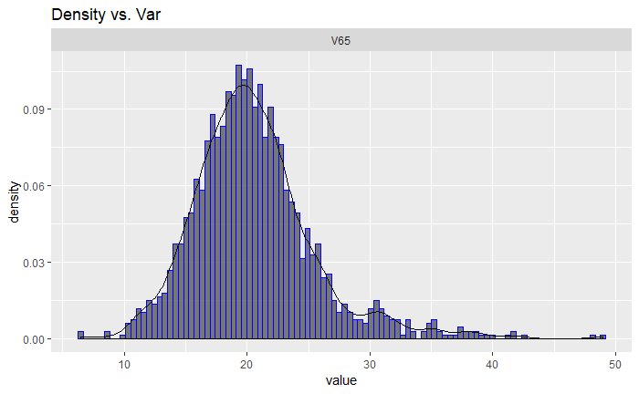
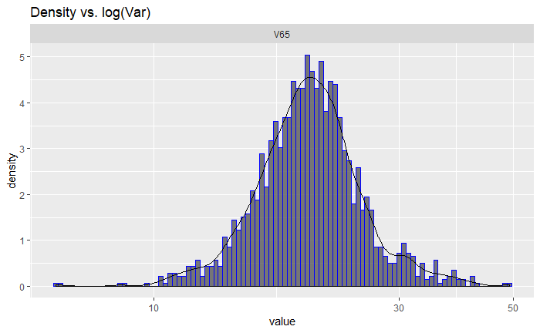
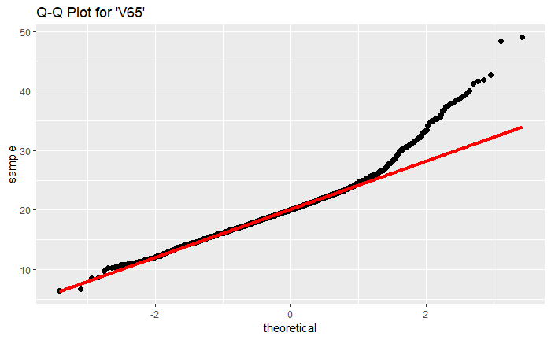
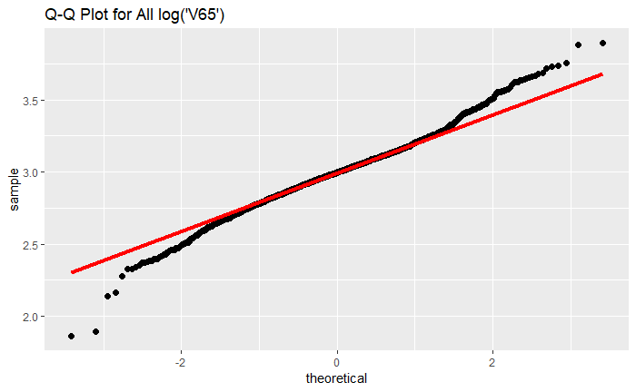
Sensor Data PDF and Q-Q Plots
Original Skewed Distribution
Log Transformed Distribution
Original PDF is right skewed.
Skewed distributions are log() transformed into normal distributions.
Distributions with negative values are translated to positive values before log() transformation.

Slide 11
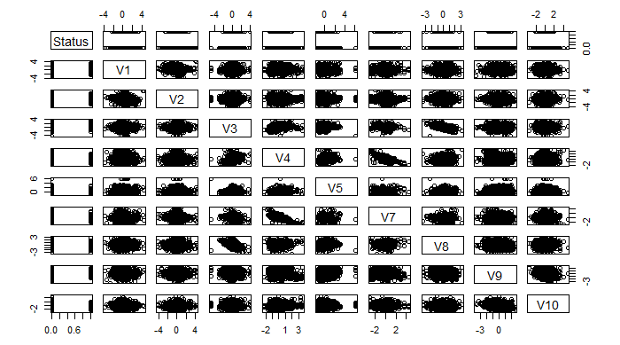
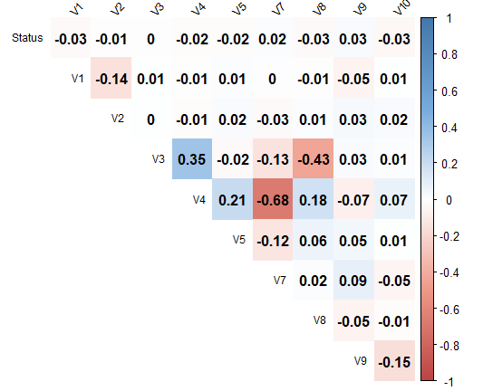
Scatter Plots and Correlogram (abbreviated)
Pairwise variable correlation analysis is useful for reducing feature space.
1st ten sensors and dependent variables shown here.
Perfect correlation → slope = +1.
Perfect anti-correlation → slope = -1

Slide 12
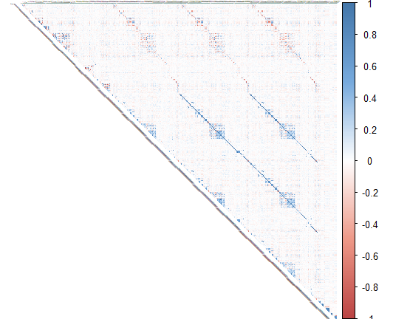
Correlogram (all features)
Plot shows clusters of high correlation.
Highly correlated variables leads to inconsistent models.
Full dataset is too cumbersome to visually reduce correlated variables.
Will instead rely on regression coefficient significance testing to remove insignificant features.

Slide 13
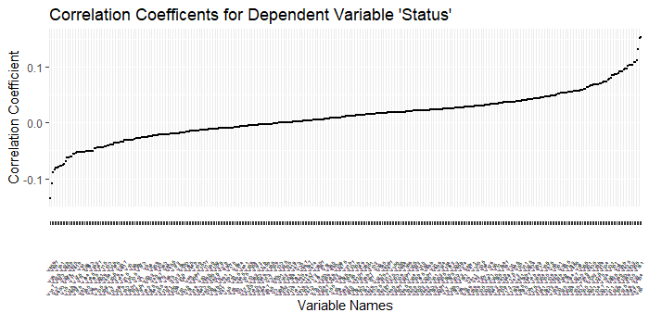
Dependent Variable – Regressor Correlations
Relationship between dependent variable ‘Status’ and all features ordered by correlation value.
No significant correlation with and any given sensor.
Models are expected to contain many combined features.

Slide 14
Outline
Introduction
Data Exploration
Modeling
General Logistic Model
Random Forest
Conclusion and Recommendations

Slide 15
Logistic Regression Model Performance
TP = true positive
FP = false positive
TN = true negative
FN = false negative
CP = TP + FN = condition positive (data)
CN = TN + FP = condition negative (data)
PP = TP + FP = predicted positive (model)
PN = TN + FN = predicted negative (model)
Confusion Matrix
 |  | Data
 |  | Status = 0 (pass) | Status = 1 (fail)
Predicted | Status = 0 (pass) | TP | FP
 | Status = 1 (fail) | FN | TP
True Positive Rate
TPR = TP/CP
True Negative Rate
TNR = TN/CN
Accuracy
ACC = (TP + TN) / (CP + CN)
F1 Score
F1 = 2*(TP/PP)*(TP/CP) / (TP/PP + TP/CP)
False Positive Rate
FPR = FP/CN
False Negative Rate
FNR = FN/CP

Slide 16
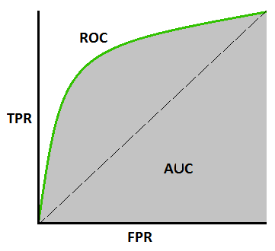
Receiver operating characteristic (ROC) Analysis
Diagnostic test for ability of a binary classifier model as its discrimination threshold is varied between 0 and 1.
AUC = area under the ROC curve.
An AUC score of 0.5 corresponds to having little discernibility or little predictability better than chance and is represented by the 45 degree dashed line.
A score of 1 corresponds to perfect discernibility and is represented by a curve that tends to the upper left-hand corner.

Slide 17
Outline
Introduction
Data Exploration
Modeling
General Logistic Model
Random Forest
Conclusion and Recommendations

Slide 18
Baseline Logistic Regression Modeling Flow

Slide 19
Data Split
 | Observations | Percent | Pass | Fail
All Data | 1567 | 100.00 | 1463 | 104
Train | 1332 | 85.00 | 1244 | 88
Tune | 157 | 10.02 | 146 | 11
Test | 78 | 4.98 | 73 | 5
Dataset is split into 3 mutually exclusive sets:
Train – 85% of data used only for model training
Tune – 10% of data used only for parameter tuning.
Test – 5% of data used only for final test
Each subset contains approximately the same ratio of pass:fail observations.

Slide 20
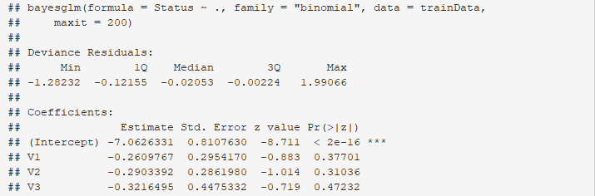
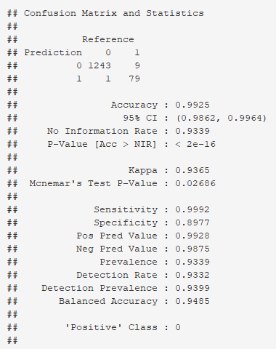
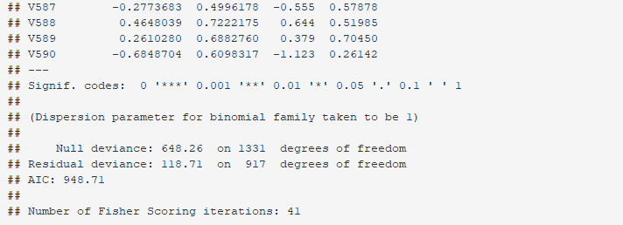
Baseline Model – Generalized Linear Model
Model Result
Training Data Model Performance
Baseline model used as reference to beat.
Fits all features.
Sample of model results shows many insignificant features.
Baseline AIC score = 949.
Model performance:
TNR (specificity) = 89.8%
TPR (sensitivity) = 99.9%
Accuracy = 99.3%
F1 (not listed) = 99.6%
.
.
.

Slide 21
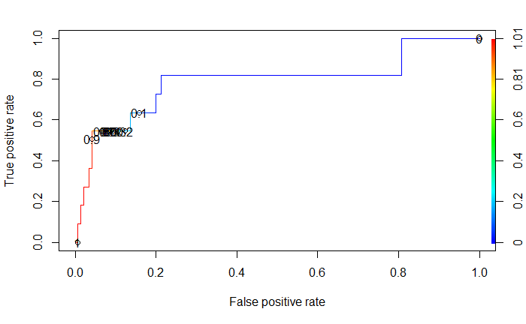
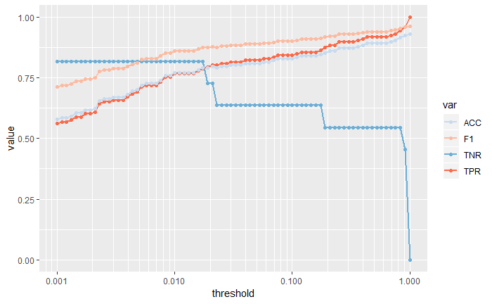
Baseline Model - Tuning
Target threshold where TNR = Accuracy.
AUC = 78.9%
AUC = 78.9% show moderate model ability to discern pass/fail .
Tuning range is very difficult to read on ROC curve so dependencies plotted versus threshold at right.
TNR is of primary concern.
Want to minimize false positives.
Optimum threshold occurs where TNR and accuracy curves intersect.

Slide 22
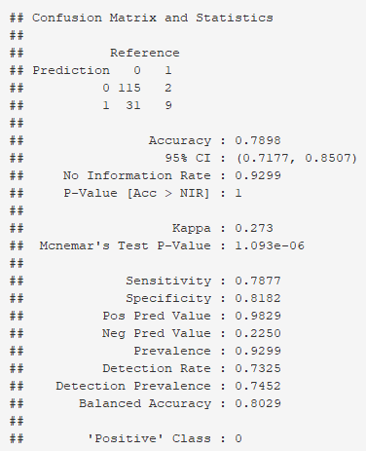
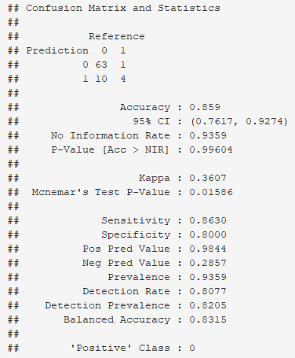
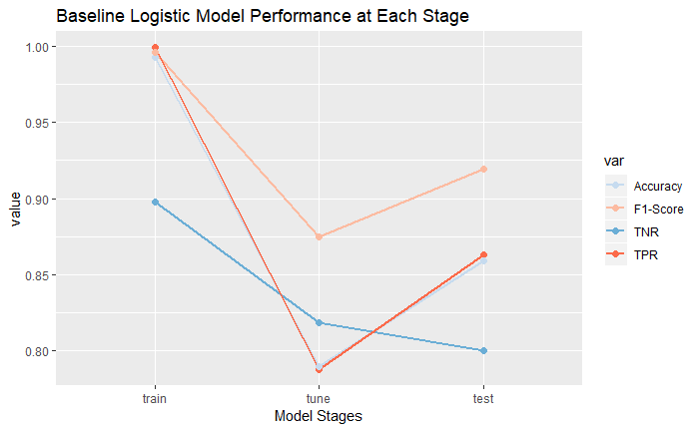
Baseline Model – Performance
Training Data Model Performance
Test Data Model Performance
AIC | #Features | AUC | Threshold
949 | 414 | 0.7889 | 0.0174
Model | Stage | TPR | TNR | Accuracy | F1-Score
logistic | train | 0.9992 | 0.8977 | 0.9925 | 0.9960
logistic | tune | 0.7877 | 0.8182 | 0.7898 | 0.8745
logistic | test | 0.8630 | 0.8000 | 0.8590 | 0.9197

Slide 23
Iterative Logistic Regression Modeling Flow
Significance test

Slide 24
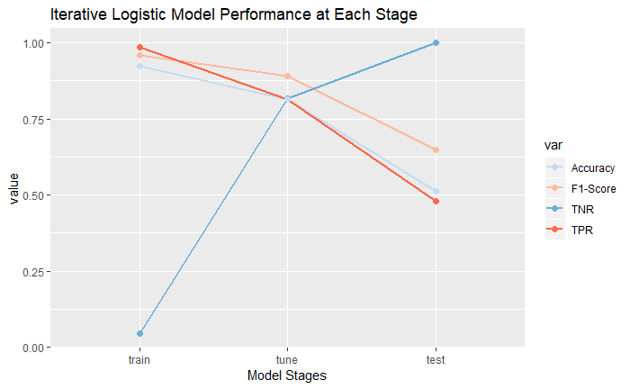
Iterative Logistic Regression – Summary
Model Summary
AIC | #Features | AUC | Threshold
515 |  | 0.9066 | 0.1000
Model | Stage | TPR | TNR | Accuracy | F1-Score
iterated logistic | train | 0.9855 | 0.0455 | 0.9234 | 0.9601
iterated logistic | tune | 0.8151 | 0.8182 | 0.8153 | 0.8914
iterated logistic | test | 0.4795 | 1.0000 | 0.5128 | 0.6481

Slide 25
Class Balanced Iterative Logistic Regression Modeling Flow
Training Dataset Summary
Before & After Rebalancing
 | Observations | Pass | Fail
Original | 1332 | 1244 | 88
Balanced | 2476 | 1244 | 1232

Slide 26
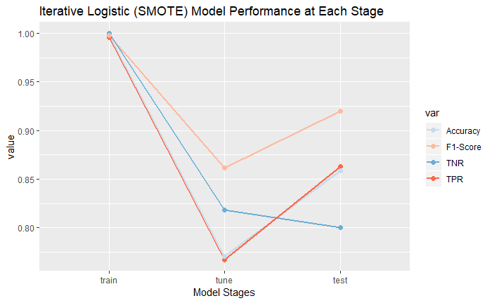
Class Balanced Iterative Logistic Regression - Summary
Model Summary
AIC | #Features | AUC | Threshold
457 |  | 0.8207 | 0.0174
Model | Stage | TPR | TNR | Accuracy | F1-Score
iterated logistic (SMOTE) | train | 0.9960 | 1.0000 | 0.9980 | 0.9980
iterated logistic (SMOTE) | tune | 0.7671 | 0.8182 | 0.7707 | 0.8615
iterated logistic (SMOTE) | test | 0.8630 | 0.8000 | 0.8590 | 0.9197

Slide 27
Outline
Introduction
Data Exploration
Modeling
General Logistic Model
Random Forest
Conclusion and Recommendations

Slide 28
Random Forest Modeling Flow

Slide 29
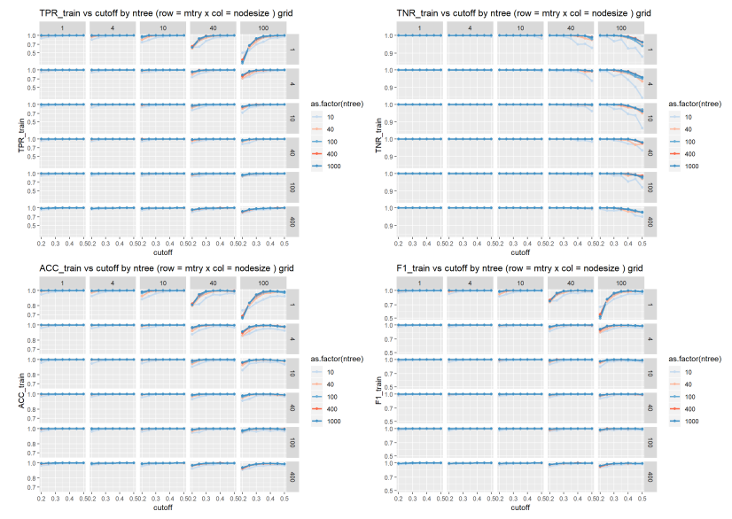
Parameter Trends – Training Data
TPR, TNR, accuracy and F1 vs cutoff faceted by mtry and nodesize.
Training data models suggest a wide range of perfect fits (TNR = TPR = accuracy = F1 = 1)

Slide 30
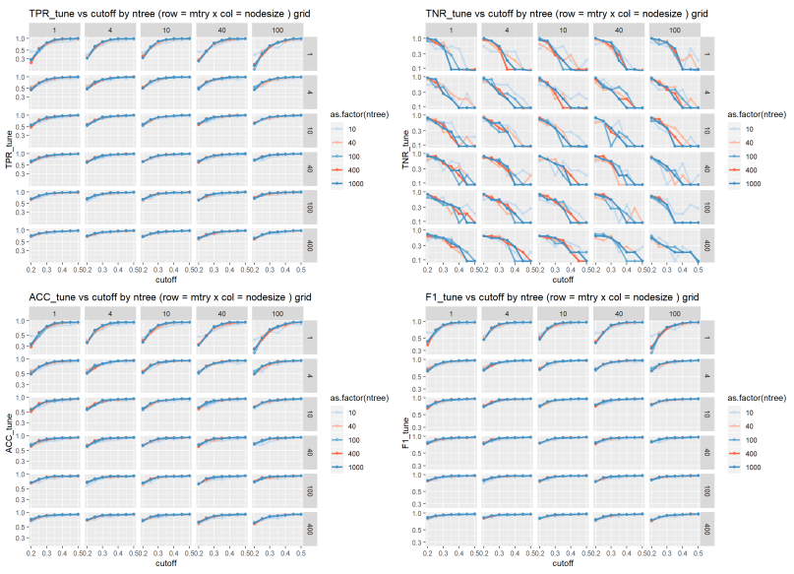
Parameter Sensitivity Plots – Tuning Data
Applying unseen tuning data to the same models reveals overfitting still a problem for TNR.
NO perfect fits attainable.
TRP and TNR have opposing dependences.

Slide 31
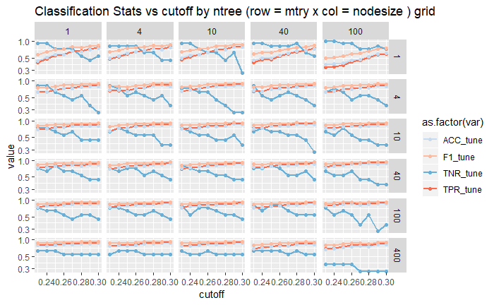
Random Forest Model Tuning
Cutoff functions for random forest models similar to threshold for logistic regression.
Optimum model is obtained from cases where TNR ~ accuracy.
Optimum model chosen:
nodesize = 1
ntree = 400
maxit = 10
mtry = 40
cutoff = 0.25

Slide 32
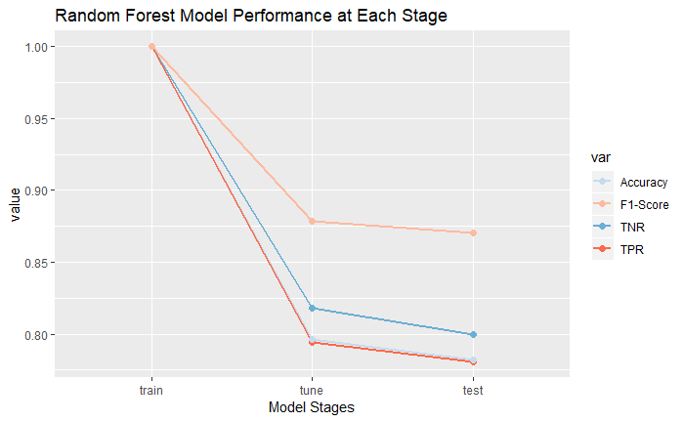
Random Forest - Summary
Model Summary
Model | Stage | TPR | TNR | Accuracy | F1-Score
random forest | train | 1.0000 | 1.0000 | 1.0000 | 1.0000
random forest | tune | 0.7945 | 0.8182 | 0.7962 | 0.8788
random forest | test | 0.7808 | 0.8000 | 0.7821 | 0.8702

Slide 33
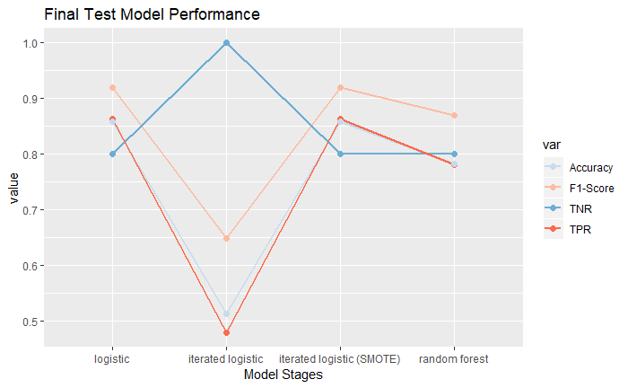
Model Comparison Summary
Model Summary
Model | Stage | TPR | TNR | Accuracy | F1-Score
logistic | test | 0.8630 | 0.8 | 0.8590 | 0.9197
iterated logistic | test | 0.4795 | 1.0 | 0.5128 | 0.6481
iterated logistic (SMOTE) | test | 0.8630 | 0.8 | 0.8590 | 0.9197
random forest | test | 0.7808 | 0.8 | 0.7821 | 0.8702

Slide 34
Outline
Introduction
Data Exploration
Modeling
General Logistic Model
Random Forest
Conclusion and Recommendations

Slide 35
Conclusions
The baseline logistic model utilizing all 414 features yielded a model performance of TPR = 0.863, TNR = 0.8, accuracy = 85.9% and F1 score = 91.97%.
A more efficient model with the same predictive power as the baseline model was the iterated logistic model applied to class balanced data which yielded a model performance of TPR = 0.863, TNR = 0.8, accuracy = 85.9% and F1 score = 91.97%, but used only 139 features.
The random forest model performance was slightly lower than the above logistic models (TPR = 0.7808, TNR = 0.8, accuracy = 78.2%, F1 score = 87.0%), but the stability in the model from tuning to test stages suggests the model is a very good runner-up.

Slide 36
Future Recommendations
The power and utility of random forest was evident in the initial training results, but even using class balanced data and optimizing on the ‘cutoff’ parameter, the model still suffered from over fitting. The next step for this dataset is to apply algorithm ensemble techniques mentioned earlier for addressing class imbalance. In particular XG Boost, an extreme gradient boost algorithm based on trees, is of interest due to its out-of-the-box performance, versatility in tuning parameters and parallel processing capability.
The biggest problem with the current dataset was not having any information about the sensor data. If the physical meaning of the measurements were available it would be possible to perform feature engineering to transform the data based on the underlying physical meaning.
The pass/fail criteria is another unknown. If this criteria was available it would provide additional feature engineering support or suggest additional sub classifications, meaning there may be more than one failure criteria at work which affects which sensors are more relevant for each failure type. The current model assumes the same sensors are important for all failures which is not correct.

